Slide 1
Finance in Mission
Diocese of London – Data strategy to support deanery planning...
Helen Simmons/Deaneries Conference / Oct 2012

Slide 2
A different approach
London Diocese:
5 Areas: Edmonton, Willesden, Stepney, Kensington 2Cities
24 Deaneries
440 Parishes
Planning for Finance and Mission takes place at all 4 levels but in very different ways………
London Diocesan Fund (LDF) – strategy to support planning at all levels with uncontentious data reporting

Slide 3
What key things happens where?
Diocese level
Allocation to an Area of clergy numbers, including annual budgeted cuts/additions
Area level
Clergy allocation, managing vacancies
Stewardship Conferences and other training events
Deanery level
Common Fund Strategy (Sometimes)
Training events

Slide 4
What’s new since 2010?
Taken the Annual Return data for finance and mission for the last 10 years
Created an Excel model that automatically produces pdf files of 18 different graphs for every:
  Parish, Deanery, Area and the whole Diocese
  (c500 pdf files)
(Use our own estimates for gap years)
Notes:
440 pdf files automatically run off at push of 1 button

Slide 5
What did we do with them?
Talked a lot about them when out and about
Shared them on screen at wide variety of meetings
Push me – Pull You strategy for distribution
Did it work?
Majority of Areas have requested theirs
More than half deaneries have requested theirs
About 25% of parishes have requested theirs
Notes:
Over last 2 years

Slide 6
Diocese of London 10-Year Finance Summary

Slide 7
Diocese of London 10-Year Finance Summary

Slide 8
Diocese of London 10-Year Finance Summary

Slide 9
Diocese of London 10-Year Finance Summary

Slide 10
Diocese of London 10-Year Finance Summary

Slide 11
Diocese of London 10-Year Finance Summary

Slide 12
Diocese of London 10-Year Mission Summary

Slide 13
Diocese of London 10-Year Mission Summary

Slide 14
Diocese of London 10-Year Mission Summary

Slide 15
Softly Softly
At LDF we see all levels of the data – we collect it and the charts help inform our strategies eg Our support strategy
At Area Planning events we make available ‘Your Deaneries, Your Area and the Diocesan level’
At Deanery level we give ‘Your Deanery (not others), Your Area and the Diocesan level’
At Parish level we give ‘Your parish (not others), Your deanery and Your Area and Diocesan levels’
If all parishes in a deanery agree to share their parish level results we can then give Deaneries all the parish charts for every parish in their deanery

Slide 16
Compare a Parish to the Deanery trend
Parish
Deanery
Notes:
PCCs can look to see where they may be diverging from trend within their deanery – if they all share their results can identify those with better performance and learn what they are doing

Slide 17
Compare your Deanery to the Diocese trend
Deanery
Diocese
Notes:
Same deanery chart compared to the Diocesan level – which other deaneries and areas can provide lessons/stories – or Can this deanery in this case provide the stories and the lessons for others!

Slide 18
Parish
Deanery
Notes:
If the deanery have set a shared Deanery Common Fund strategy – that could relate to ‘covering individual parish costs’ ‘covering deanery costs collectively’ , ‘Pairing up to cover costs’ ‘all getting to a similar % of Unrestricted income they are providing’ or to ‘increase offers by a % equally’. This comparison shows how they are doing

Slide 19
Deanery
Diocese
Notes:
This comparison then challenges them against the trend in the whole diocese – 12% v 22%....

Slide 20
Parish
Deanery
Notes:
Similarly with Mission charts -
What is happening at this parish with USA and % Children attending? How are others in the deanery increasing the % of children attending – compare to 25% in Another Capital Idea

Slide 21
Deanery
Diocese
Notes:
Same deanery chart compared to the Diocesan level – which other deaneries and areas can provide lessons/stories?

Slide 22
Where Next?
Once our Deaneries begin to systematically agree to share their parish charts collectively we can provide the tools to help………
Eg Intra Deanery comparisons – but for 1 year only……

Slide 23
Compare Individual parishes next to each other

Slide 24
What else are we doing?
Parish Dashboards:
5 of the Key 10 year Charts from the 18 available
Deprivation summary data
Trusts available
School connections (if any)
Balance Sheet data (we collect by annual return)
Key People
To come – Census data, November 2012

Slide 25
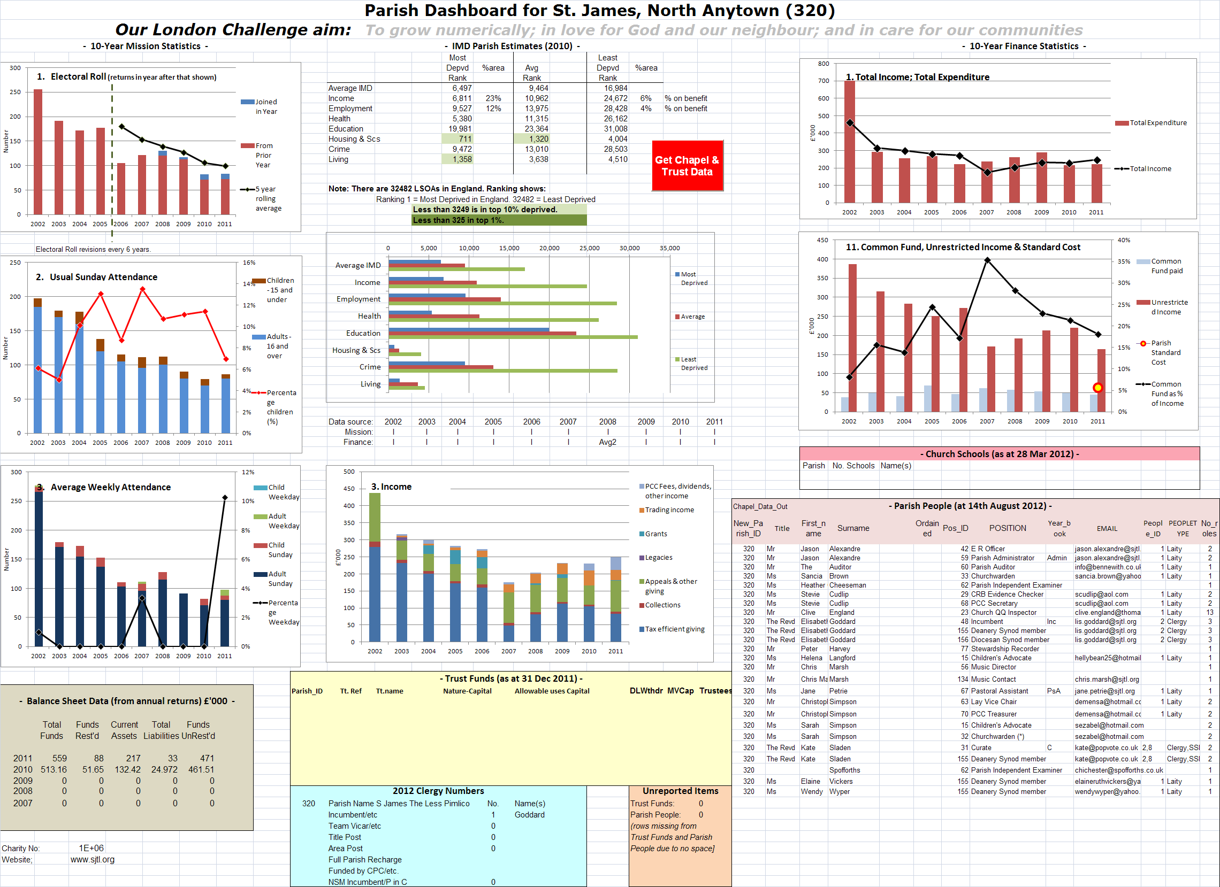

Slide 26
How are the Parish Dashboards used?
Initially by archdeacons and bishops for visitations – background info
Now – by parishes – eg churches about to come together, wanting to compare their situations
Deaneries? Perhaps we will develop a Deanery Dashboard next……..

Slide 27
Final Thoughts/Questions
Role of Diocese in supporting Deanery Planning
Do we as a diocesan office have a duty to re-distribute Annual Return data throughout the diocese itself in this way? We’ve seen it as a ‘Nice to do’ but now we think it must be embedded – should it be a core function.
Sensitive Data
Should we share everyone else’s data/charts via the website and let deaneries/parishes help themselves? Are we being oversensitive? Where are the sensitivities over data?
What More
What more could Diocesan offices be doing to support Deanery planning?

