Slide 1
Finance in Mission
Jonathan Hill – Director of Finance
National Deaneries Conference – October 2012

Slide 2
Lichfield Diocese
  Population of just under £2m
  583 Churches/427 Parishes
  29 Deaneries (of varying size)
  3 Episcopal Areas
  Mixture of Rural and Urban
  158 Urban/ 141 Rural – 128 mixed
  Share is 72% of our income
  Receive £1.9m in Central Support

Slide 3
Issues Facing Lichfield
  Two main issues and all centre on Resources
  First we need to lose £2m of costs over the next five years – unless we put up the share by large undeliverable amounts
  We have at least 96 stipendiary clergy retiring in those five years – we have banned moves out !!!

Slide 4
Sustainability
  In January 2011 an initiative was launched called “Plain Speaking”
  It is designed on the Toronto model of comparing Mission Strength and Finance Strength
  Every Deanery has undertaken the exercise

Slide 5
The Sustainability agenda
The Church of England aims to encourage “a flourishing Christian presence in every community.”

Slide 6
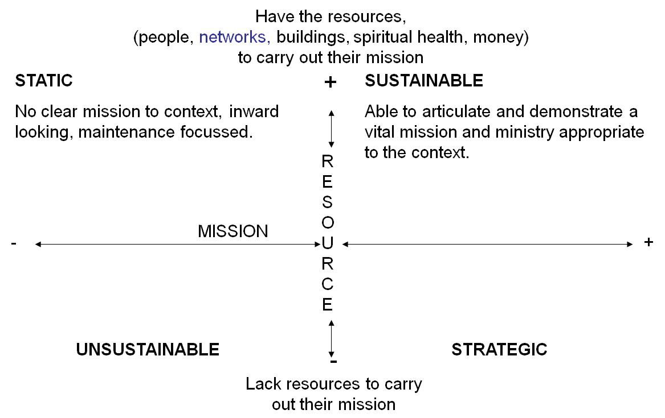

Slide 7
Financial Resource Indicators
+ or – Ministry Contribution as % (R or C).
Overall Share Receipts.
Surplus or Loss over the last three years.
% Increase or Decrease in TVI (Total Voluntary Income)
Size of reserves as a percentage of Average Annual Expenditure.

Slide 8
Sustaining Mission and Ministry in the Diocese of Lichfield

Slide 9
Mission and Church Health Indicators
Opportunity Engagement
Going for Growth by:
Discovering the Heart of God.
Growing Disciples.
Reaching New Generations.
Transforming Communities.
Practising Generosity.

Slide 10
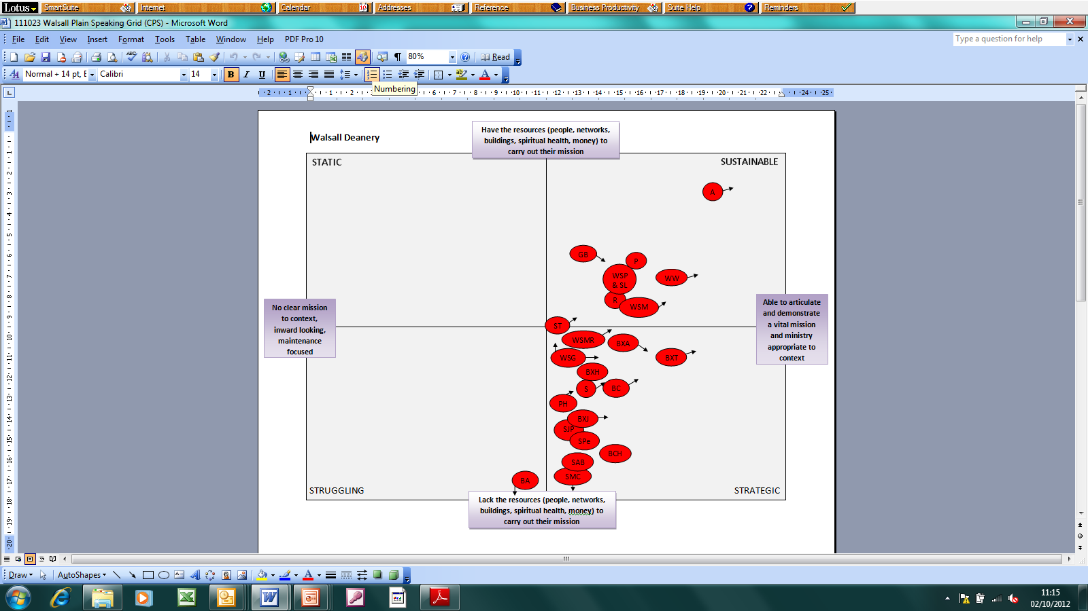

Slide 11
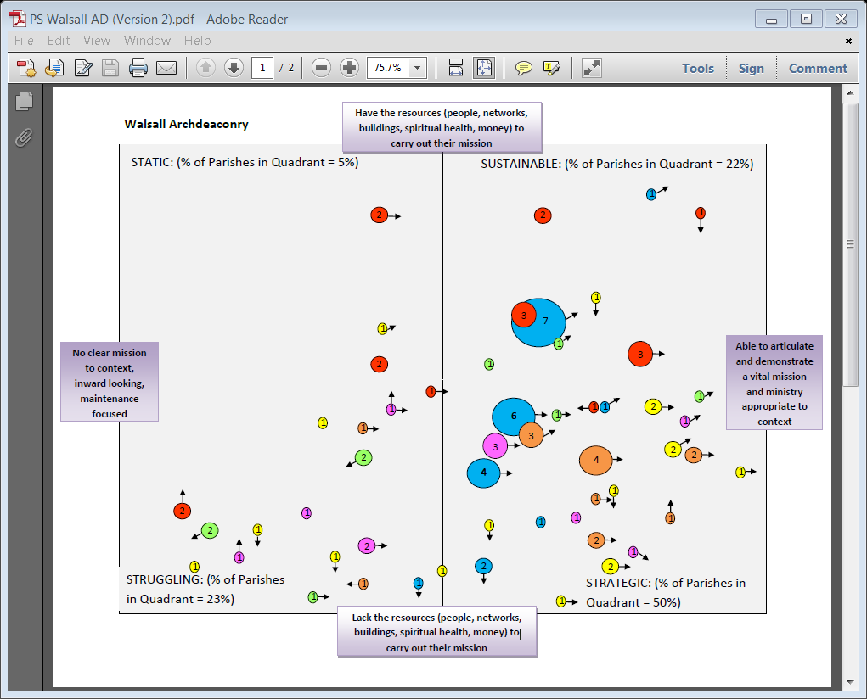

Slide 12
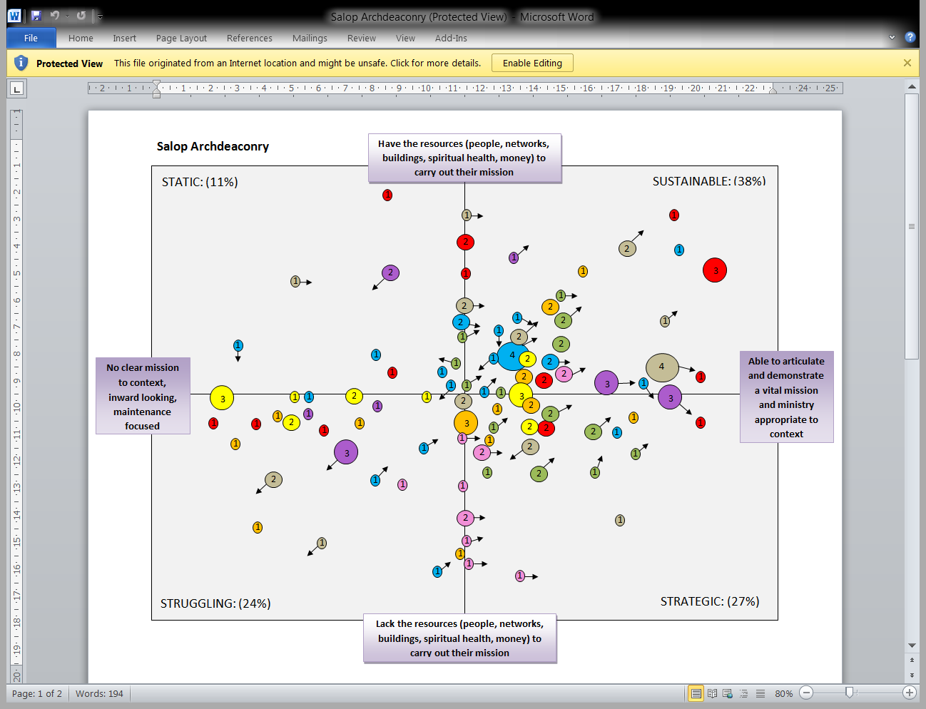

Slide 13
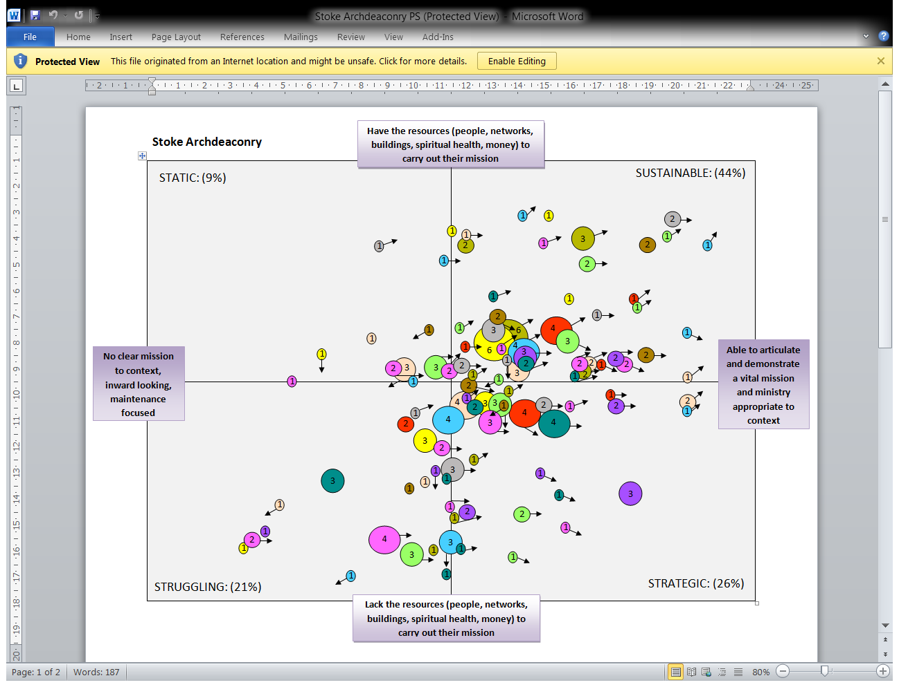

Slide 14
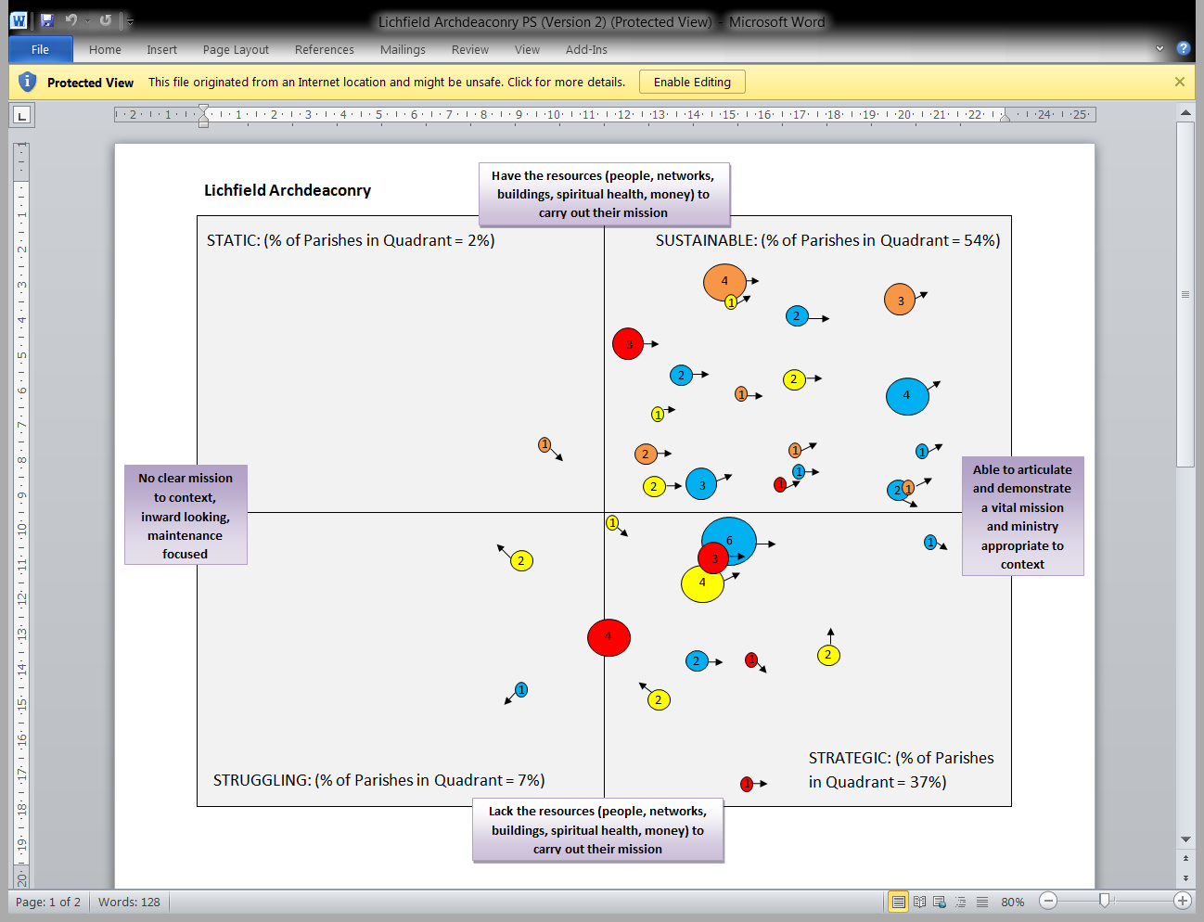

Slide 15
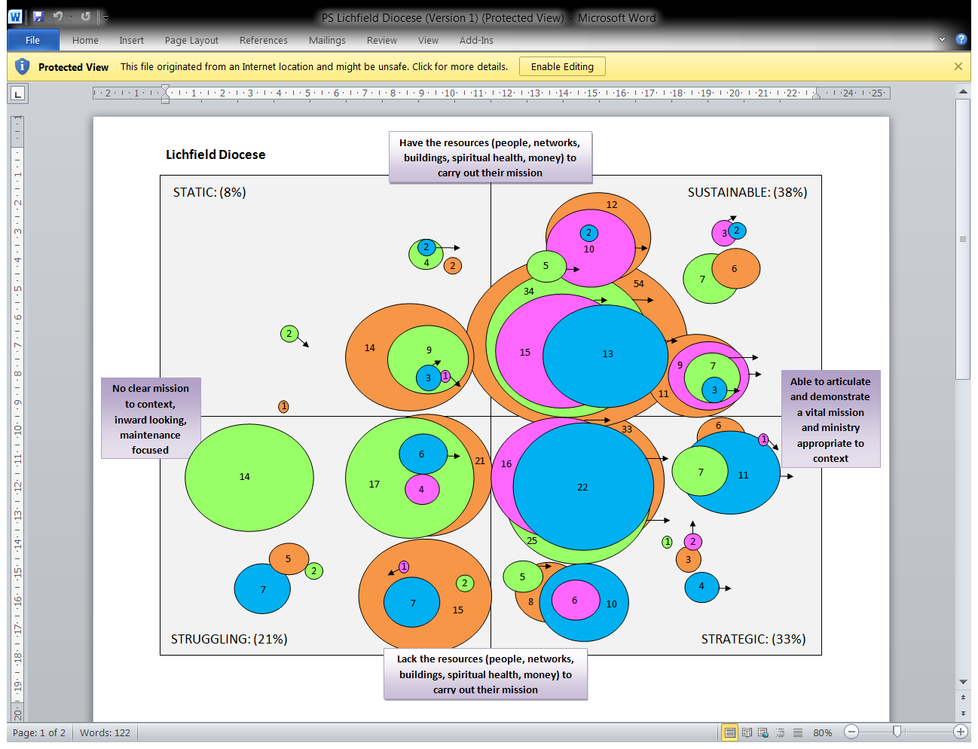

Slide 16
Encouragement

Slide 17
Mutual Support in the Diocese of Lichfield

Slide 18
Mutual Support
  Koinonia – Appears 18 times in the New Testament
  Communion, Fellowship or Partnership
  Its root meaning is Sharing
  It describes God’s Communion with us and with each other
  Paul expounds the purpose and significance of this collection in 2 Corinthians 8-9. it is an expression of Koinonia between churches. It springs from the grace of God – ‘grace’ is shorthand for the generous, undeserved love God for us

Slide 19

Plain Speaking and Parish Share
Plain Speaking
Parish Share

Slide 20
New Share Formula
  Based on Cost of Ministry – no such thing as a free vicar.
  Average Cost with support £49,390
  Apply Mutual Support and apportion support from the Church Commissioners
  A K ratio – divide the share paid by the adjusted Cost of Ministry
  Aim for K to equal 1.1 – pay for your costs plus 10% towards other mission and ministry

Slide 21
New Share Formula
  The new formula allows parishes to decide on what is affordable
  Plan deployment
  Know their share for up to 3 years in advance
  Allow parishes to discuss with their neighbours requirements and deployment needs
  Share the saving……..

Slide 22
  “What are the mission opportunities in our deanery that should be pursued as priorities?”
  “Are there places where pastoral re-organisation would now be appropriate?”
  “Which parishes need particular encouragement? What resources do we have at our disposal to offer?”
  “What problems or issues have presented themselves that require further investigation?”

Slide 23
  How can we as a whole Diocese respond with :
  training (diocese-wide or locally);
  resources (financial, personnel, administration);
  policy decisions (youth/children; suspensions);
  creative budgeting;
  Other?
  How do the five ‘themes for Growth’ guide our response/planning?

Slide 24
Factor X
  In all our forecasts - Factor X
  The unknown, unknown.
  Become apparent it is Buildings
  Need to include the average cost of a QQ over a five year budget when looking at the sustainability of the Parish.

Slide 25
Practising Generosity
  Just writing a new five year strategy with the Diocesan Bishop on Practising Generosity
  Tax efficient Giving
  Talents/Time and Tithing
  TRIO (The responsibility is ours)
  Mission and Ministry right then in theory and often in practice the finance takes care of itself.

Slide 26
Vision
Take forward the spiritual and numerical growth of the Church of England – including growth of its capacity to serve the whole community of this country
Re-shape and reimagine the Church’s Ministry for the century to coming, so as to make sure that there is a growing and sustainable Christian witness in every community
Focus our resources where there is both greatest need and greatest opportunity.

Slide 27
Finance in Mission
Jonathan Hill – Director of Finance
National Deaneries Conference – October 2012

Slide 28
Area Priest with
Local Ministry
Covenanting parishes with variety of ministries and “focal” ministers
28

Slide 29
The Enterprise Model
Community projects to develop ownership, opportunity and pastoral contact
29

Slide 30
Clustering and
Covenanting Churches
Local and district arrangements to share ministry and resources
30

Slide 31
Other considerations….
Think Church Planting - Church planting has been a major source of growth in the 1990s, across all denominations
Think Networks - The parish system is an excellent way of covering the population geographically. However most people today relate to others through networks, rather than geography
Think Ecumenically - Other churches are wrestling with the same issues
31

Slide 32
The Minster Model
Major church acting as source of ministry to serve churches in a district
32

Slide 33
Cell Church Development
Alternative model rooted in small groups (variety of ages) to serve neighbourhood as a network
33

