Slide 1
BISHOP SACKS AREA DEANS

Slide 4
Diocese of Bristol vital statistics
Population: 1 million
Churches: 204
Benefices: 103
Regular attendees: 30,000
Average Weekly attendance: 18,000
Clergy - stipendiary 125
- self-supporting 75
Parishes raise £15m
Parish Share £5.2m
Diocesan Expenditure £7.5m

Slide 5
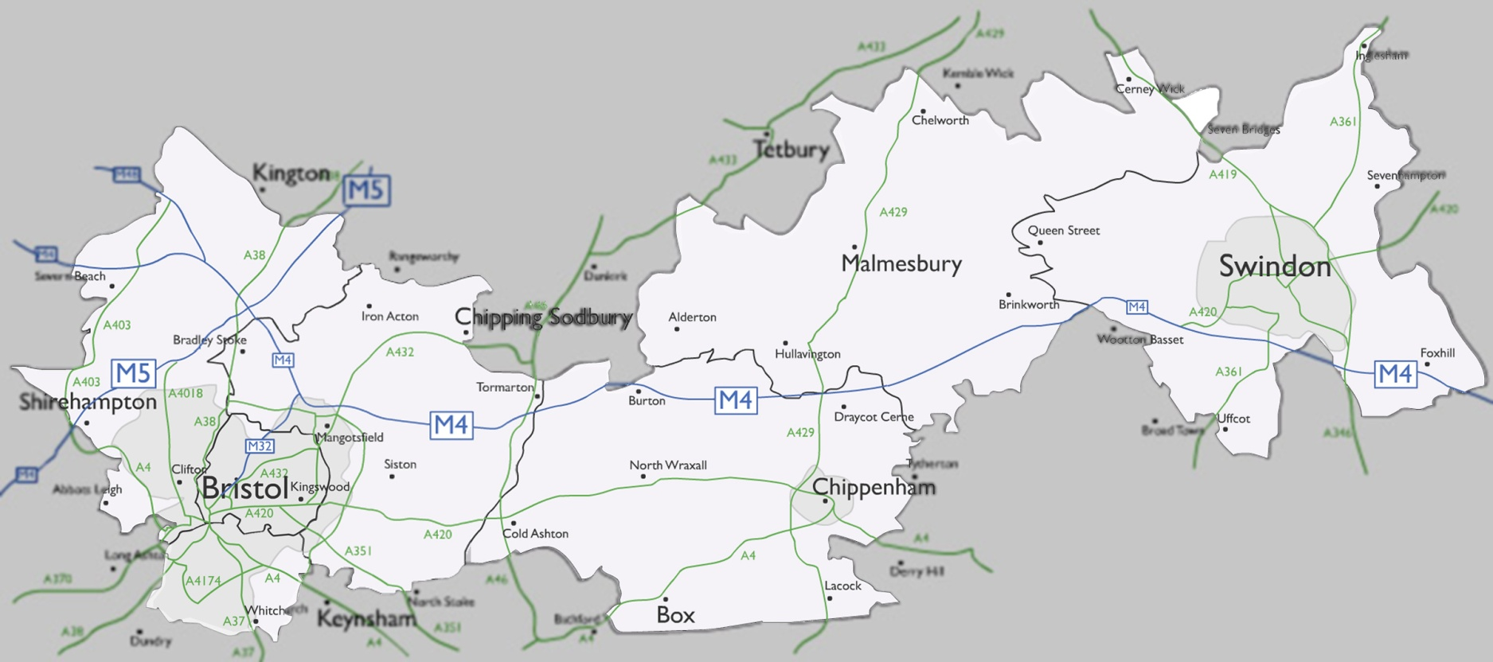
Seven different deaneries

Slide 6
What the Diocese is about
Setting direction focused on...
Recruiting, developing, deploying ministers for...
Providing resources, governance and making decisions for...
Being an interdependent community of faith for...
... God’s mission and the growth of His Kingdom

Slide 7
Subsidiarity
“a matter ought to be handled by the smallest, lowest, or least centralized authority capable of addressing that matter effectively”

Slide 8
Interdependence
Diocese of Bristol | National Deaneries Conference 2012

Slide 9
Releasing the Energy | Diocesan Strategy 2010-2015

Slide 10
Releasing the Energy | Four strands to the strategy
Growth Programme
Leadership Development
Income generation
Structures of oversight and support

Slide 11
Deanery responsibilities
Encouraging the Growth Programme locally
Recommendations about deployment
Managing Leadership Development in Vacancies
Raising Parish Share in the deanery

Slide 12
A changing relationship

Slide 13
The de- words
Decentralisation
Delegation
Devolution

Slide 14
Responsibilities
Up close and personal
Capacity building
“It’s the Area Dean, stupid!”
The deaneries’ task in God’s mission

Slide 15
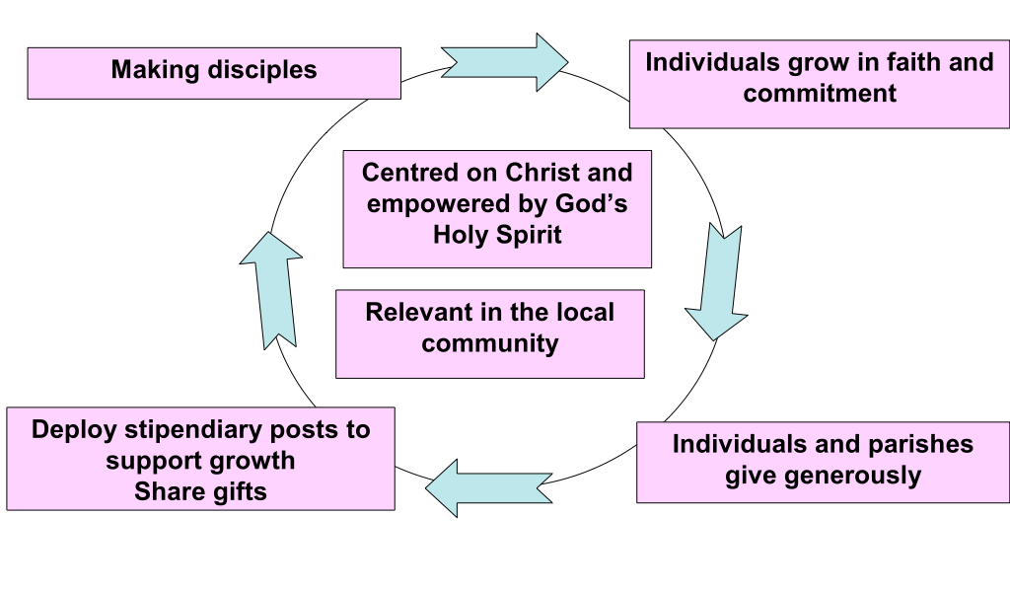
City deanery

Slide 16
Some questions
What responsibility would release energy locally if given to your deanery?
What fears would diocesan leadership have if they gave that responsibility away?
What fears would deanery leadership have if they took that responsibility on?

